Slide 1
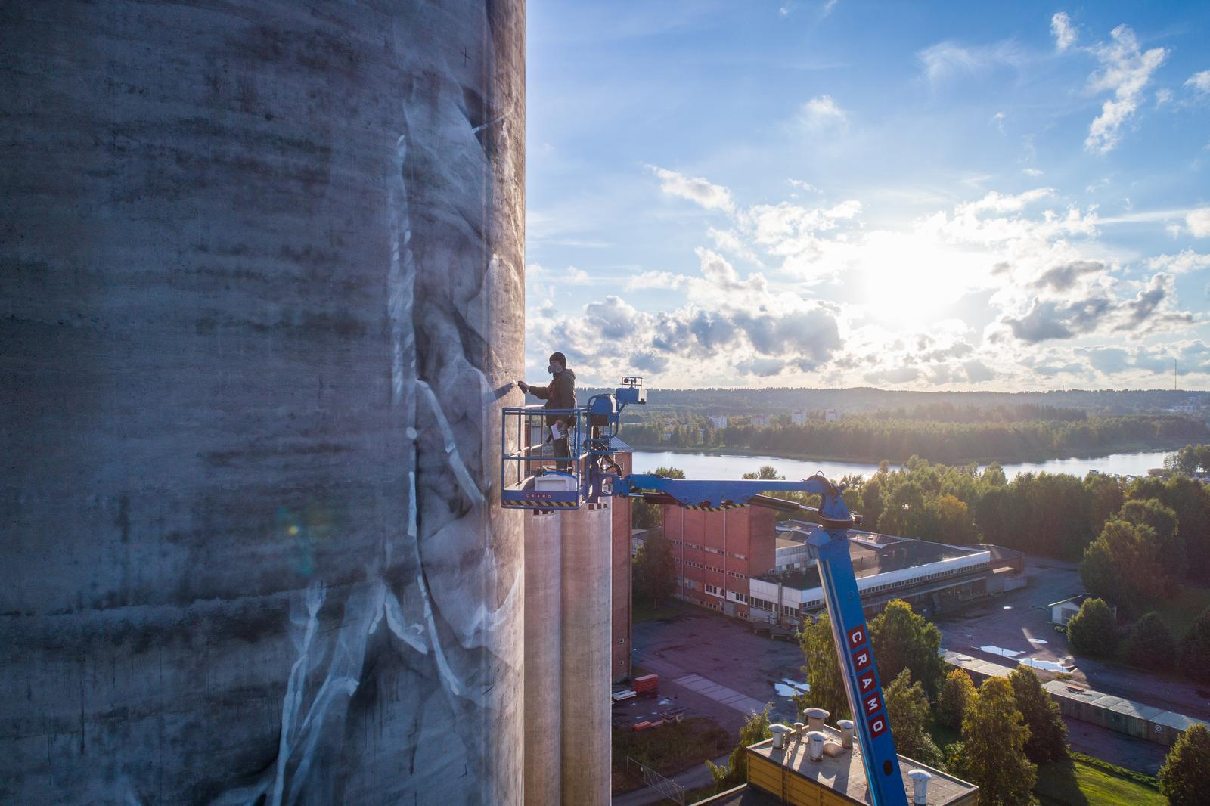
CRAMO
Shared Resources Simplified

Slide 2
CRAMO
Shared Resources Simplified
Productivity partner, digital innovator and sustainability frontrunner.
Through reliable products, services and innovative digital solutions, Cramo is a business partner increasing the productivity and work safety of our customers. Sustainability, digitalisation and focus on our people are at the core of our strategy.
We are a frontrunner in our industry.

Slide 3


Key
events
2020
Completion of Boels Rental’s acquisition of Cramo Group
Cramo was delisted from Helsinki Nasdaq in June, 2020

Slide 4


A quick overview of Boels-Cramo group
Business overview
Geographical areas
  Boels Rental Founded in 1977, family-owned generalist
  equipment rental company in Europe. CEO Pierre Boels Jr since 1996.
  Cramo founded in 1953. Stock listed company until the acquisition by Boels Rental in 2020. CEO Martin Holmgren.
  Extensive range of product offerings in equipment
  rental, services and digital solutions
Our Priorities
Availability | Safety | Sustainability | Added value | Support

Slide 5










Boels-Cramo Group
A leader in the equipment rental market
8th
7.000+
Largest worldwide
Employees
18
1.3 EUR MLD
Countries
Annual turnover
TOP 3
260.000+
In 12 countries
Customers
750+
650.000+
Depots
Rental items
2.750+
2 EUR MLD
DIY locations
Fleet value

Slide 6




Creating value for our customers
Boels and Cramo
- a strong foundation
Leading in rental
Leading the equipment rental market in Europe and 8th largest worldwide
A competitive organization better positioned for greater growth, increased profitability and with the financial strength to better manage market challenges and economic volatility.
CREATING
CUSTOMER
VALUE
A complementary geographical footprint
Stronger presence in mainland Europe,
An optimized portfolio of products and services Joint operations and improved rental expertise
Always available
Offering equipment and solutions 24 hours per day through our digital ecom platform and solutions
Extensive product range
Extensive network
Broad and young: offering over 650,000 rental products with an average age of only 46 months
Operating through 750 depots in 18 countries
there will always be a depot near you

Slide 7





Cramo Northern Europe at a glance
~1,800
~200
~100,000
employees
depots
customers
Our offering
Tools
and complete package solutions in building equipment.
Construction equipment
for all types of assignments, from major infrastructure projects to small-scale jobs.
Access
equipment
with comprehensive safety solutions for working at heights.
Building site
facilities
for various purposes
and capacity needs.
Services
on-site
value-adding
services

Slide 8
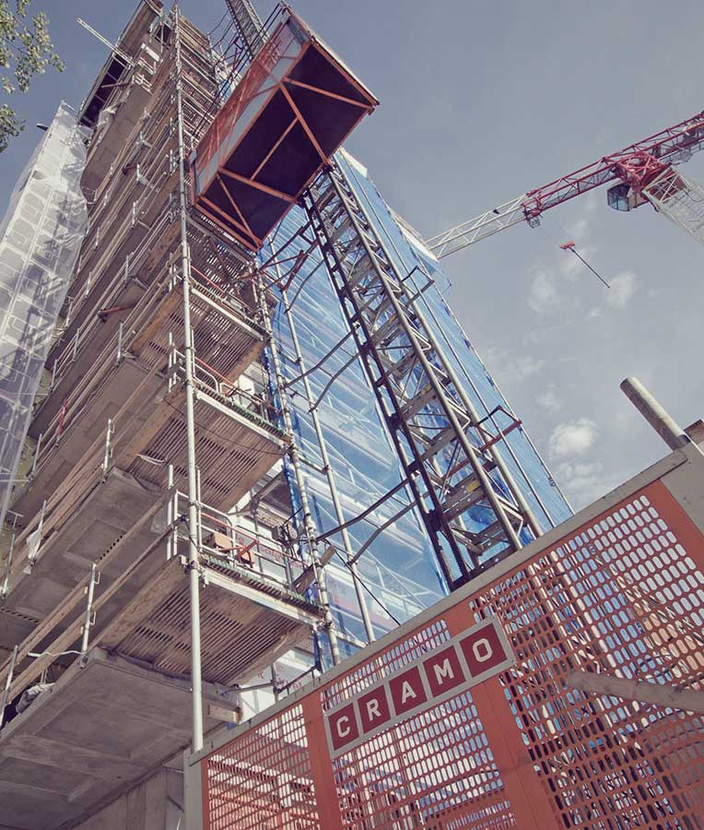
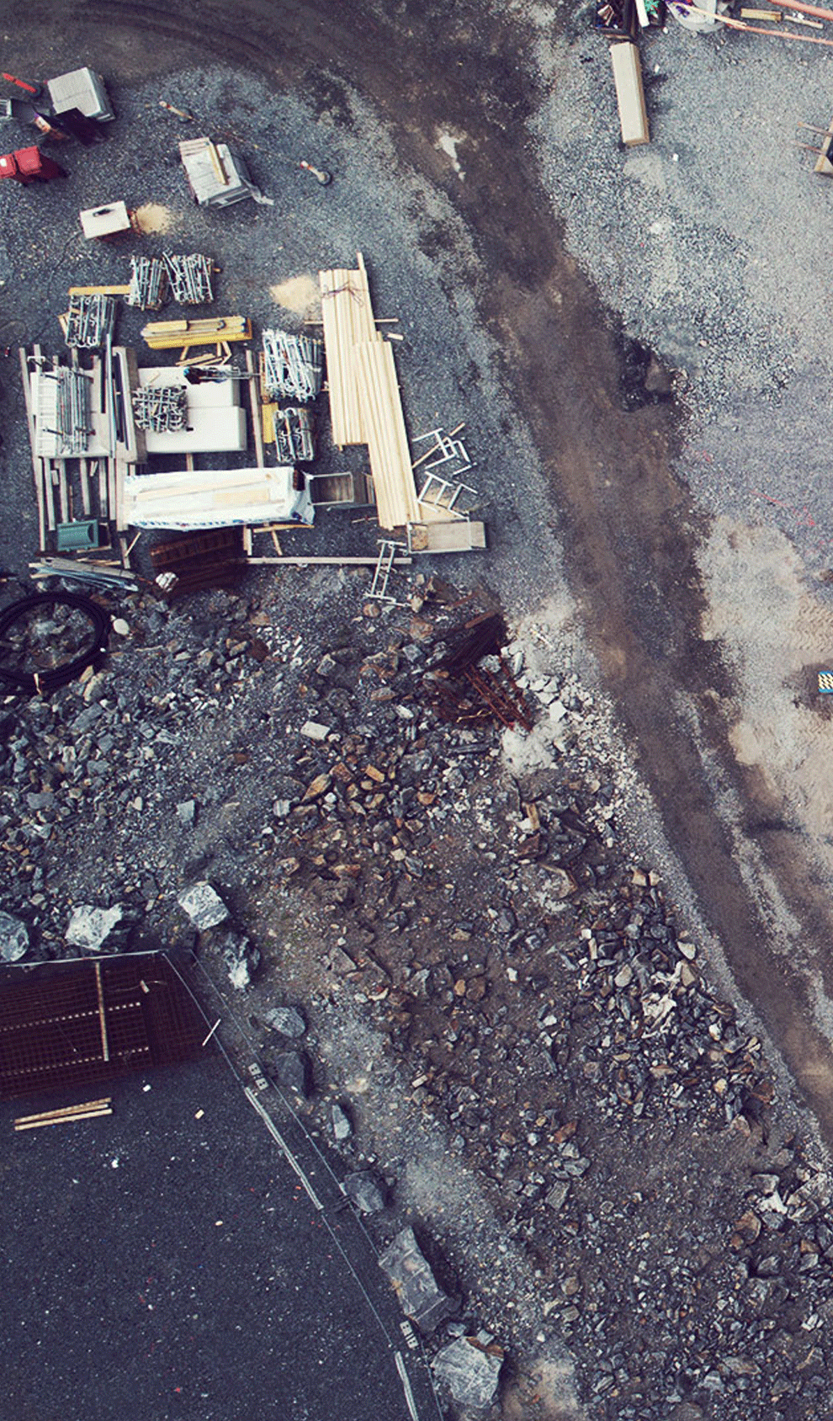
Our equipment rental solutions
Equipment
We offer any type of construction equipment for any type of construction project.
Construction productivity
We offer services that improve productivity, such as on-site logistic solutions and concepts for optimizing work productivity.
Construction safety
We offer services to improve safety, such as online instructions, monitoring, training and concepts for working in dusty environments and carbon-free work-sites.
Construction sustainability
We offer services that provide improved sustainability, such as smart concepts for saving energy on construction sites.

Slide 9
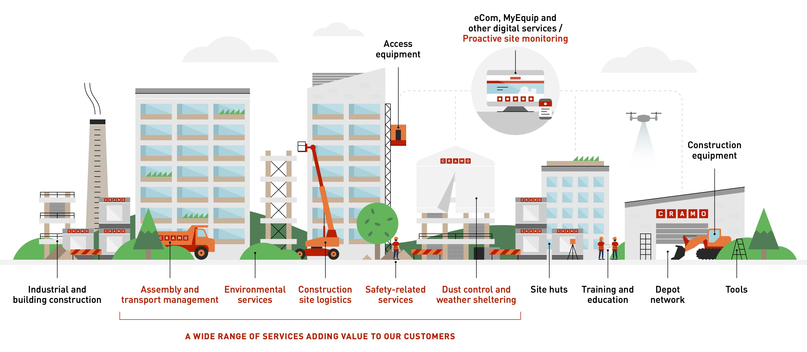
Wide range of products and services offered to meet clients’ demand
Notes:
We serve the entire construction industry – from the planning phase to the finished construction site – and focus on helping our customers increase their productivity and work safety. Our digital applications enable 24/7 communication, allowing our customers to manage their fleet when convenient. Through our digital tools we also learn how customers behave by collecting data, and can transform it into service offerings that enhance our capability to be a productivity partner in our industry.

Slide 10
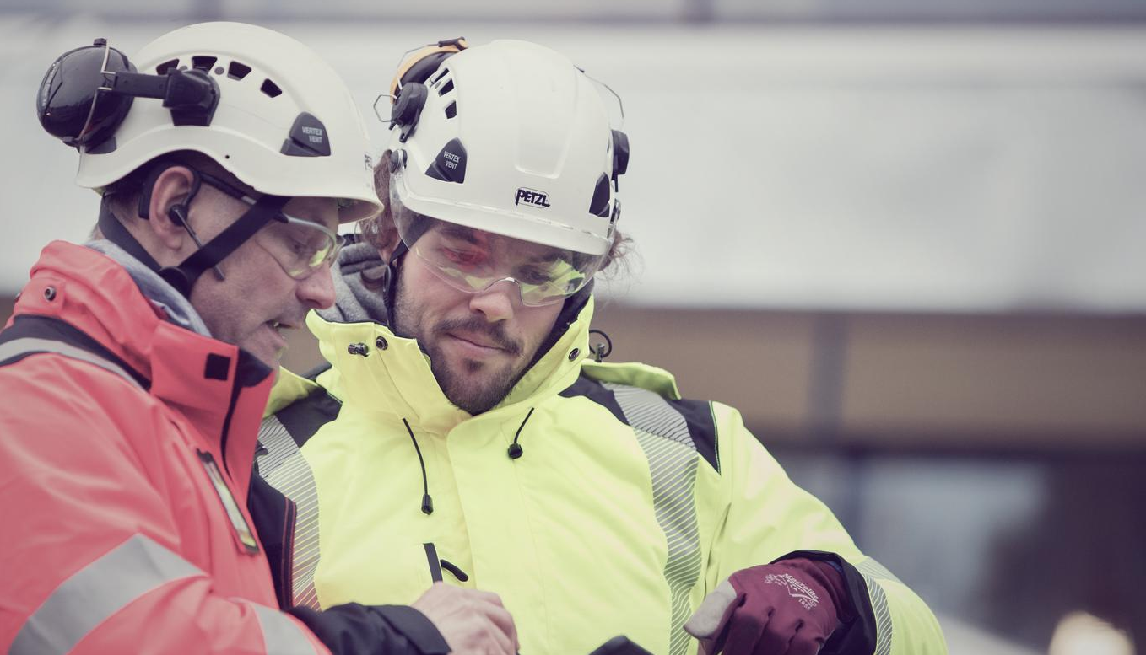
Leading partner in services
Notes:
For more than 60 years Cramo has been a pioneering force in the rental industry. Being in the forefront doesn’t only require the ability to meet customers’ needs when it comes to rental equipment, it also requires a thorough understanding of how our customers daily work is carried out.
Only with this understanding we have been able to create services to help, support and strengthen you. Our services are designed to optimize your working process, lifting your business and bringing you a great day at work. We offer services related directly to our equipment as well as certain on-site services. We also provide total solutions in selected areas.

Slide 11
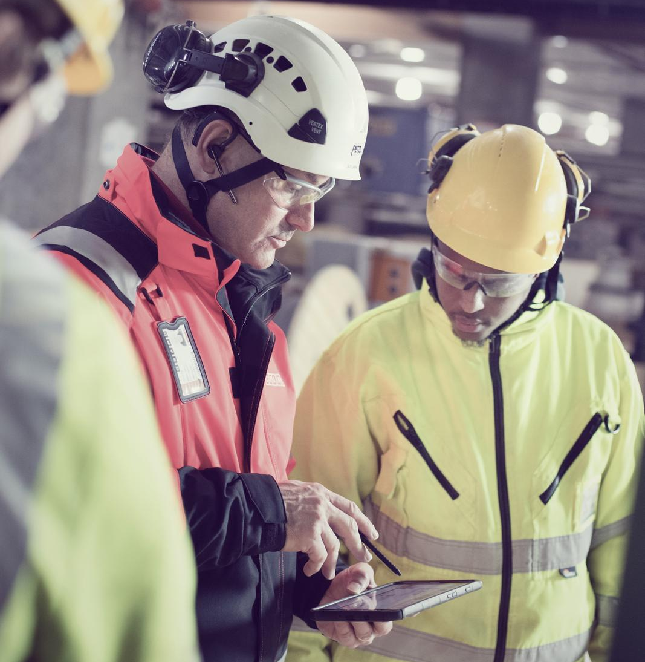
Construction logistics services
Increased productivity
Lower costs
Improved security
Reduced climate impact
Notes:
Increased productivity
Collective studies show that construction workers spend a lot of working time waiting or handling materials. In the worst case, non-value-added data can take up to 70% of working time. With improved logistics, non-productive work can be reduced and the construction process can thus be accelerated.
Lower costs
An early analysis of needs and conditions creates opportunities for cost-effective production. Less time on redundant or non-productive tasks enables focus on core competencies and helps to reduce total production costs.
Improved security
A clear structure for how to move vehicles, materials and people outside and inside the construction site creates a safer working environment. On-the-job training and communication can advantageously be included to ensure a safe and smooth workflow.
Reduced climate impact
By centralizing and consolidating the logistics flows, fewer transports go to the project site, which reduces the environmental impact and costs

Slide 12
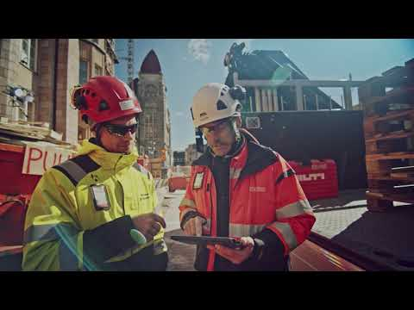
Construction logistics services
Pre-planning
On-site logistics management
Transportation co-ordination
On-site logistics
Material management
Notes:
Pre-planning
The unique need of the project is being documented, models for logistics and communication ensure that you get a well-coordinated setup that reduces lead-times.
On-site logistics management
Logistic solutions are continuously aligned with the production plan and communicated to all stake holders. With the focus on on-going planning you are always one step ahead and can concentrate fully on production.
Transport coordination
Coordinated deliveries ensure correct timing and reduce the risk of accidents at work. A planning and logging tool enables transport sharing models, thus contributing to environmental sustainability.
On-site logistics
A smooth flow of materials from unloading to installation area eliminates bottle necks. A tidy site prevents misplacement of materials and equipment. Clear traffic signs increase safety on site.
Material management
Goods control at reception and optimized storage solutions prevent materials from being misplaced, damaged or lost. Increased material availability reduces search time for workers, thanks to smart storage areas, proactive replenishment and possible kitting.

Slide 13
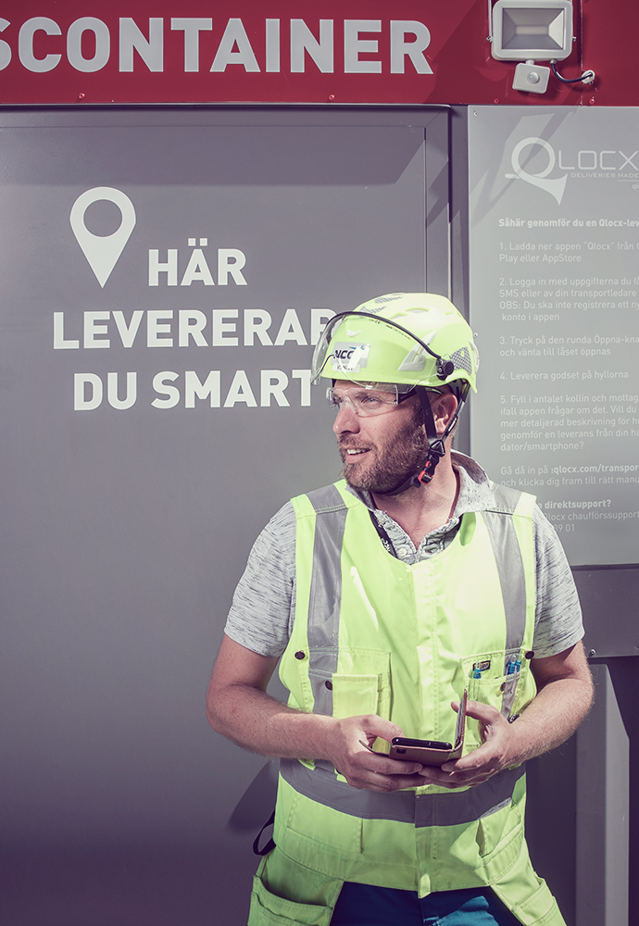
Delivery container
Customer case
for smooth delivery and return of tools
and equipment at the work site
Logistics is about having the right thing at the right time in the right place and with a delivery container, we minimize our efforts in coordinating those parameters. The container has two doors on each end, it is arranged so that it cuts through the workplace fence - one door out onto the street and the other in towards the building. It is a rather simple solution but has increased the efficiency at the work site to a large extent.
Ronny Blomqvist,
Site Manager, NCC, Sweden

Slide 14
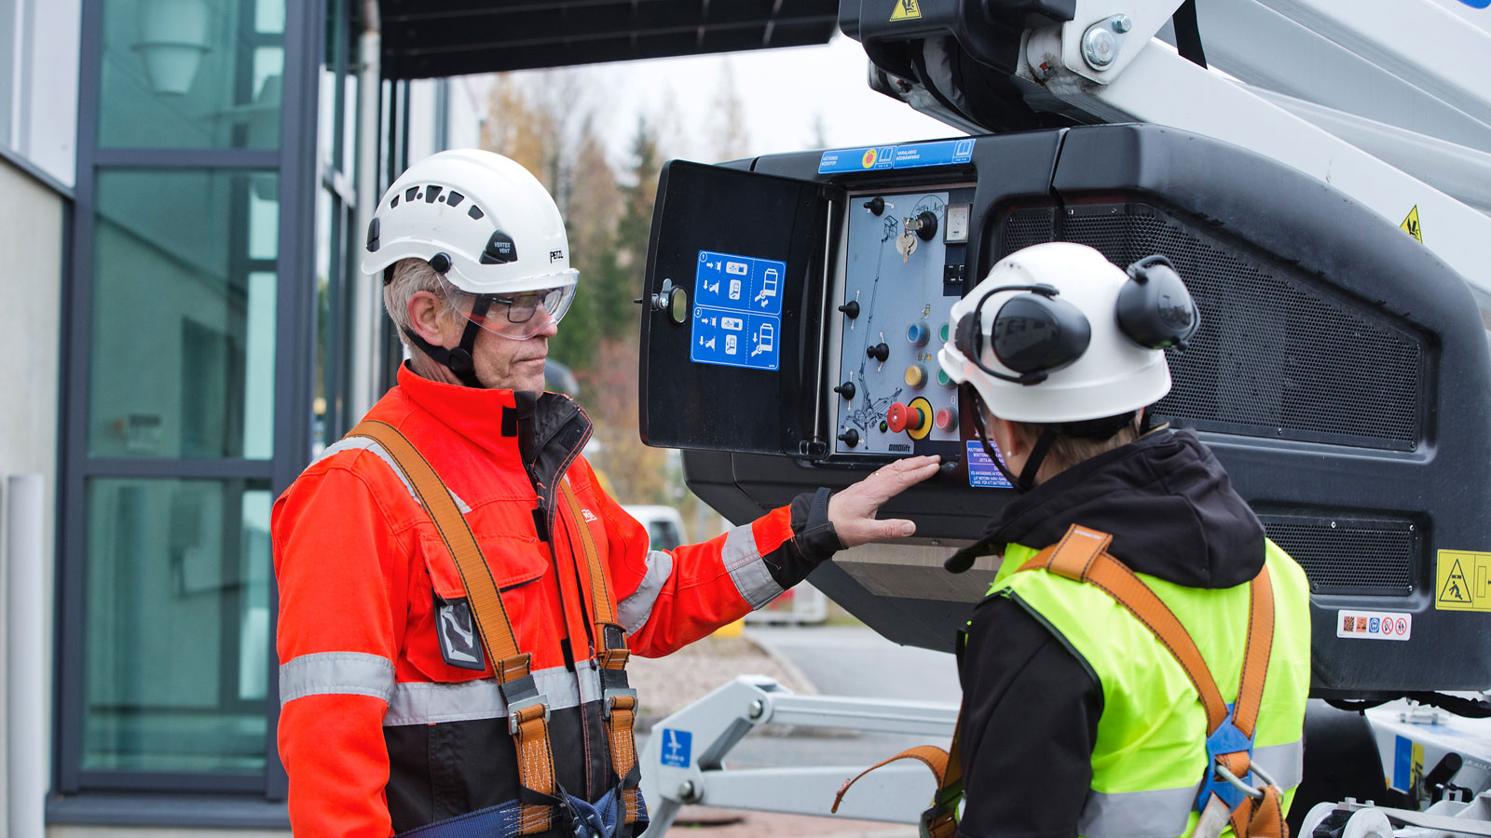
Cramo school
Proper, up-to-date knowledge and skills on how to use the equipment is key to improve safety and efficiency at the work sites.
Many years of experience from the equipment rental industry
Both internal and external training with the objective of increasing competency within a number of different sectors.
External safety training is provided in Finland, Sweden, Norway, Lithuania
Notes:
Proper, up-to-date knowledge and skills on how to use the equipment is key to improve safety and efficiency at the work sites.
Many years of experience from the equipment rental industry, and various customers, projects and applications, has built a competence within Cramo that we share with our customers in professional training. Either as class-room trainings or customized on the customer’s site.
We carry out both internal and external training with the objective of increasing competency within a number of different sectors. As a customer, you may take part in courses carried out by Cramo, e.g. a lift operator course or a scaffolding course. In order to raise the level of our environmental and quality work, all employees at Cramo complete an interactive environmental and quality training course.
External safety training is provided in Finland, Sweden, Norway, Lithuania

Slide 15
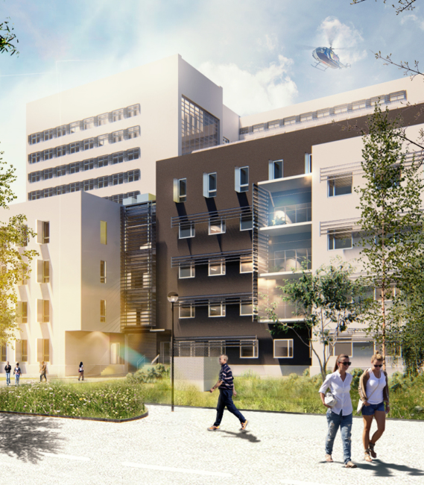
Customer case
North Estonia Regional Hospital’s
Cancer Treatment Centre of Excellence
Customer: Merko Ehitus Eesti AS
Total project size: 40m EUR
Project schedule: July 2020 to January 2023
Cramo delivers
Large site hut campus (for construction personnel as well as temporary facilities for medical functions)
Lifts for people and materials
Fencing
Scaffolding and masts
Temporary tunnel solution made of scaffolding
Transport and assembly/disassembly
Telehandler services
Temporary traffic management equipment
Heating services
Safety railings and Combisafe solutions
Fuel taxi for fuelling heaters and Access equipment
Cramo revenue: ~ €200,000

Slide 16

Industrial maintenance breaks
Customer case
Customer: Power plants, Pulp mills, steel production plants etc.
Projects: 1–3 month, 100–1500 workers each
Project schedule: Yearly
Cramo delivers:
Site offices & locker rooms
Warehouse, storage containers
Access equipment
Telehandlers
Tools
Site electricity
Etc.

Slide 17
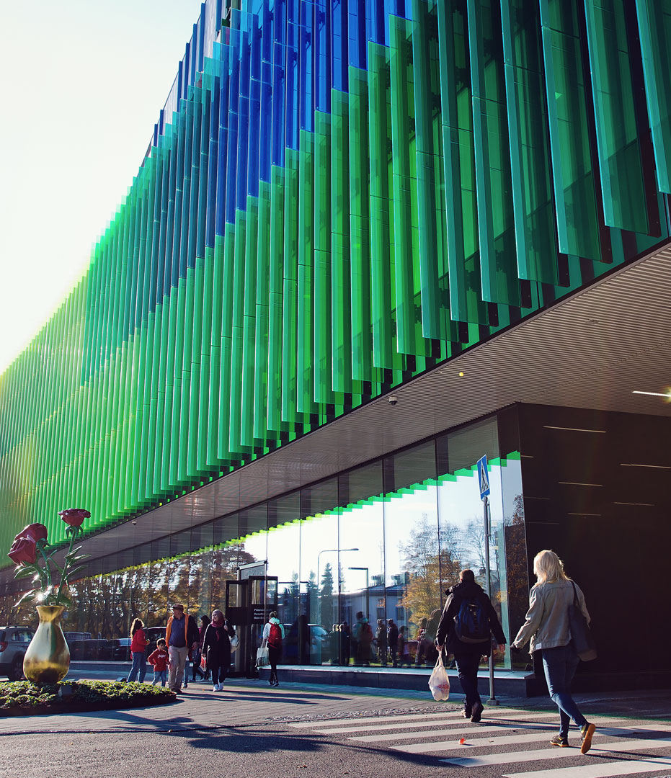
New Children's Hospital
Customer case
Customer: SRV
Project size: €170m
Project schedule: Q2/2016 – Q2/2018
Cramo delivers:
Construction site logistics
Delivery coordination
Traffic and people flow management
Loading and unloading
Transport to installation area
Site tidiness
Waste management
Safety measurement
Floor and material protection
Heating and dry construction services
Cramo revenue: ~€2.5m

Slide 18
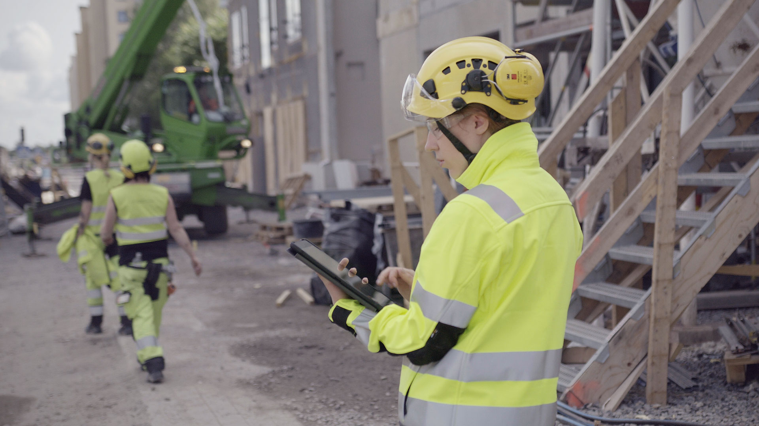
Digital leader
in the rental industry

Slide 19


CLAIMING DIGITAL LEADERSHIP
Increasing digital customer
interactions
Frontrunner for digitally enabled
business models
Creating value through
connected fleet and data
Digitally streamlined
internal operations
Increased productivity with clear value adds for customers
Improved customer journey
and user experience
Increased
fleet utilisation
Notes:
We intend to be the frontrunner for digitally enabled business models in our industry.
Insights collected throughout our operating countries guide our investment in digital solutions.
These solutions help us to ensure that we are serving our customers with clear value-adds in productivity, sustainability and safety.
To achieve this, we digitally streamline our internal operations, increase our fleet utilisation and, foremost, create added value for our customers through our digitally connected fleet and the data we receive from it.

Slide 20
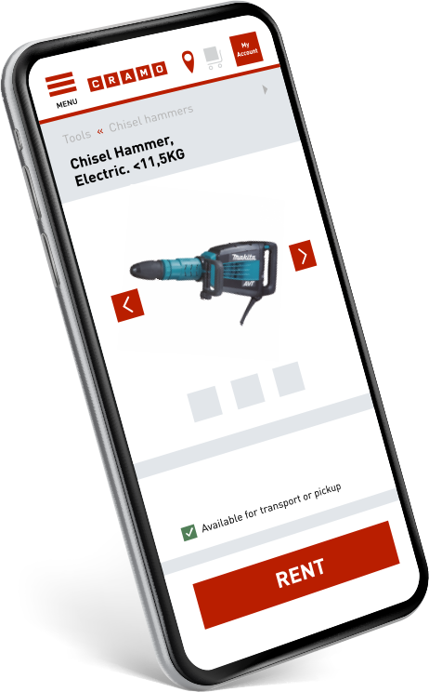
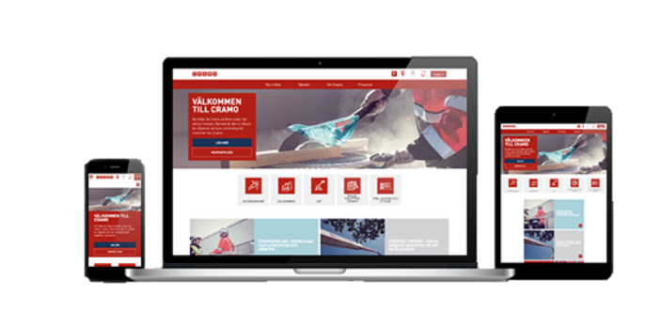
Digital platform
Our digital eCommerce platform is more than a rental tool – it also gives our customers easy management of their rental fleet and rental costs.
Notes:
Our digital eCommerce platform is more than a rental tool – it gives our customers easy management of their rental fleet and rental costs.
Every day, our sales forces work flexibly with our customers using our eCommerce offering, giving them access to the offering and up-to-date data and information whenever needed throughout the day.
We are constantly adding more services to our eCommerce platform.

Slide 21
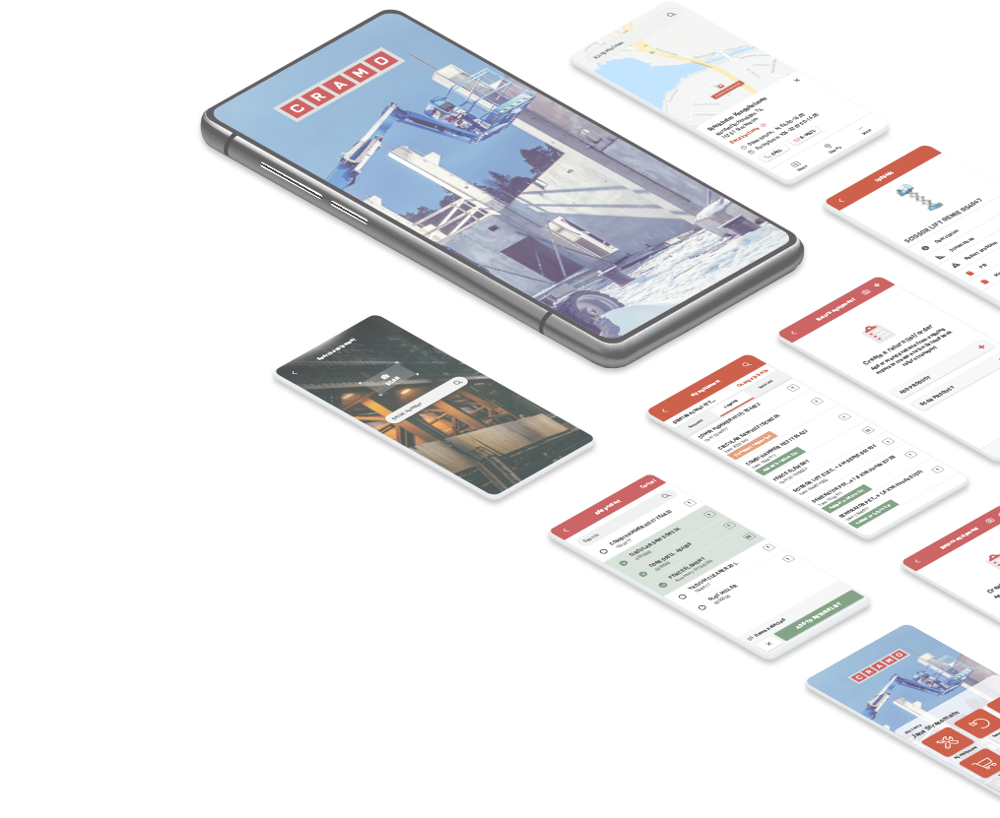
The Cramo App
Rental and services in one mobile app
Online rental
Rent and return equipment
Product viewer
Machine- and tool-specific documents
Safety instructions
My Equipment
- Listing rented equipment
Notes:
With the Cramo app you can rent and return equipment online.
The Product Viewer feature gives customers access to machine- and tool-specific documents, such as machine registration, maintenance information and safety instructions. Site managers can use Product Viewer to find very detailed information, such as what kind of oil has been used in a specific machine, which can be useful information in case of an oil leakage. The app guarantees instant access to detailed product information – a feature that is new today, but will surely be an expectation in the future.
The My Equipment functionality shows the customer what they have on rent. For example, in Stockholm there are construction sites with hundreds of units of equipment on site at any given time. The customer is usually not well equipped to keep track of these as that is outside the scope of their core business MyEquipment shows the customer what they have on rent. For example, in Stockholm there are construction sites with hundreds of units of equipment on site at any given time. The customer is usually not well equipped to keep track of these as that is outside the scope of their core business, which makes it a time-consuming and additional task. My Equipment gives the customer full transparency of what they have on rent at each construction sites, which makes it a time-consuming and additional task. My Equipment gives the customer full transparency of what they have on rent at each construction site.

Slide 22
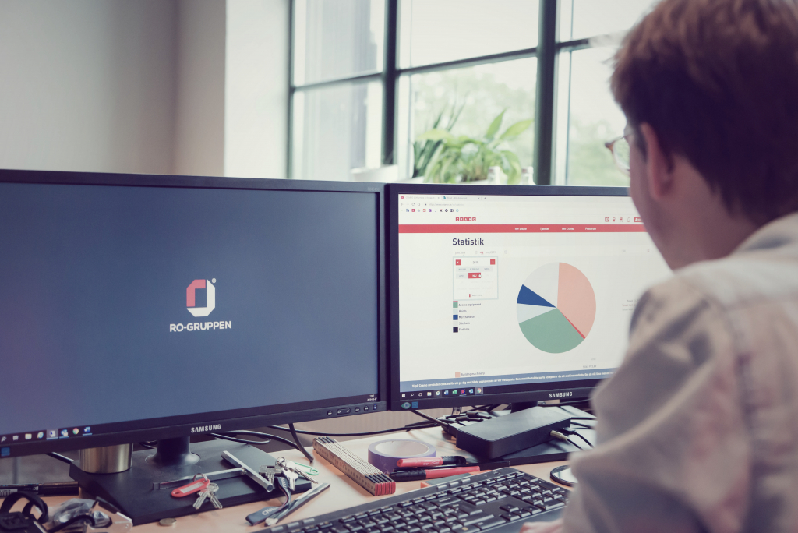

RENTING ONLINE
Customer case
70% of all rented equipment were rented online
Before we started to use the online service, we placed orders by calling or visiting the depot every week or every month and then got a confirmation by email or on our invoice each month. Now I can see updated prices in real time online, which has worked really well. It’s given me a much better overview of what things cost, and I’ve been able to make adjustments with the help of quick feedback from Cramo.
Axel Lindström, RO-gruppen
Sweden

Slide 23
Mats Asdahl
Mynd Entreprenør AS, Norway
I am very satisfied with Cramo's new web shop. This service makes it very easy to see what I have rented and it also reminds me to return equipment that we no longer need at our jobsite – it helps me save money.
I also find it very important that I have quick and easy access to our rental invoices, but I also have a convenient overview of what my people have rented on different jobsites.
Reserving equipment is so easy. When I need to work outside the business ours, I can still book the equipment that I need for the dates that I need.
With many varied assignments, it is important for us to stay ahead of the planning and coordination of equipment for the various projects. Therefore we want to quickly use services that can help us with this.
Cramo is our supplier when we rent machinery and equipment. When they launched the opportunity to rent online through the web portal, this was very interesting for us. We got a review and start-up help from a salesman from the Cramo department in Porsgrunn, and then it went off by itself. Now I guess around 80% of what we rent from Cramo is through the web portal.
Meelis Levkoi
TRV Kliima AS, Estonia

Slide 24
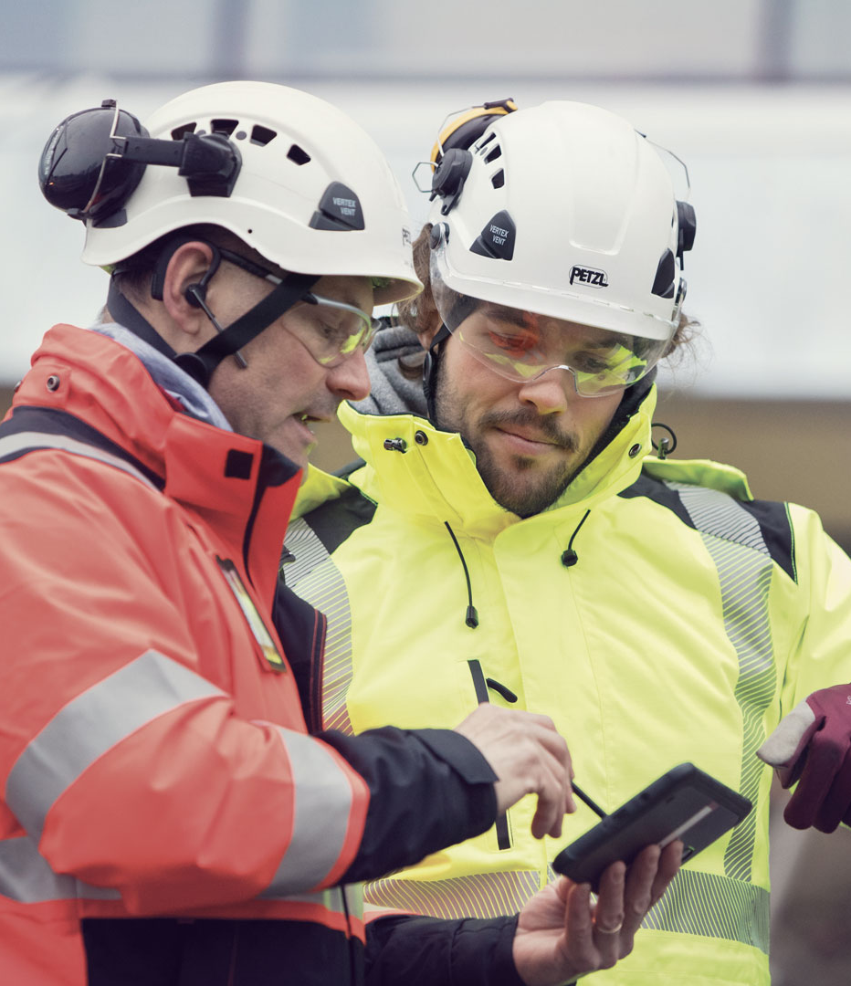
I have good experiences about Cramo’s digital services, and I use them regularly. Online Rental provides a good overview of rented equipment in jobsite and the information of returned rentals. We also monitor invoices from the e-portal.
The eGate is a new digital service that I have been very pleased with. It measures the temperature and relative humidity of the building and I can follow the numbers from my own workbench in real-time. That way we can ensure the best condition for the building to dry.
Overall, I don’t have anything to complain about. Like any digital tool, you need to use it and get familiar with it
Veijo Koskinen, Responsible foreman
Finland

Slide 25
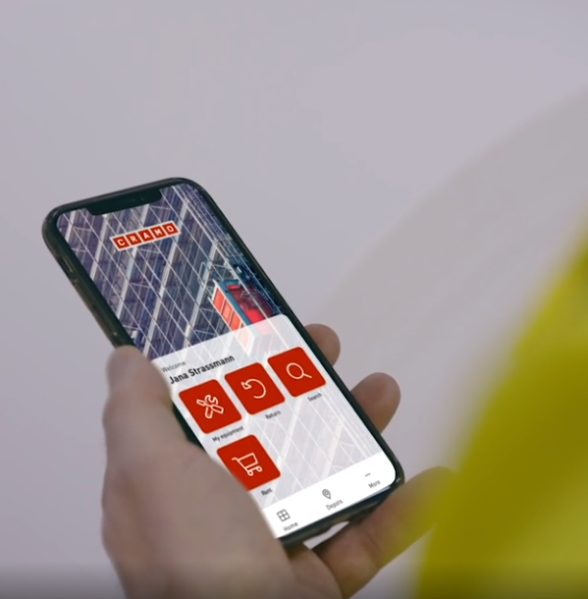
We are glad to have possibility to use your company's online-rental service. This service has been very helpful in coordinating the useage of rented equipment when we are planning weekly jobs, we do not rent too much equipment and the amount of equipment rented is optimized that way.
As a result, the cost of rented equipment for our company decreased by about 8-10%.
It is also important that we no longer have to walk around the factory and look for how much and what kind of rental equipment we have, we see everything in our computer at the touch of a few buttons.
Edvinas Vainius
Mechanical group manager
AB „Grigeo Klaipėda

Slide 26
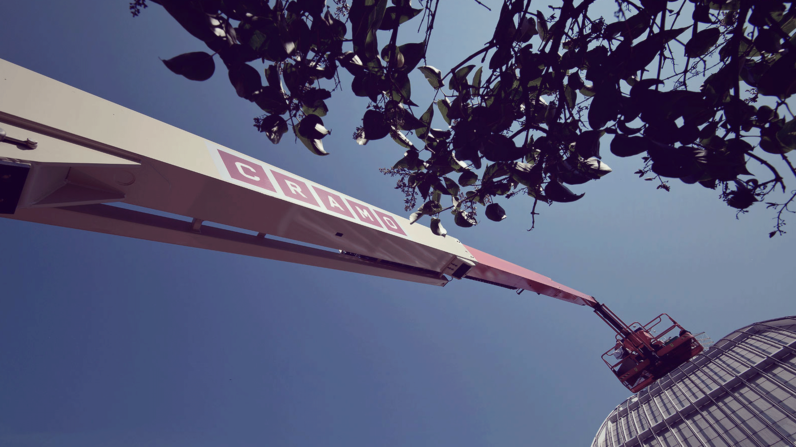
Our strategic approach to sustainability
CRAMO CARE

Slide 27
Responsible sharing of resources is the core of our business. Our ambition is to work together with our customers and other stakeholders to further decrease the environmental and social footprint of rental equipment and to meet customer demands by focusing on sustainable customer use, transports and logistics and sustainable sourcing.
Our strategic approach to sustainability
CRAMO CARE

Slide 28

Key elements of our sustainability strategy
1. Moving towards Circularity
2. Cramo Care – our model for responsible business
Notes:
1. Moving towards circularity
The circular economy aims to design out waste and introduces a strict differentiation between consumable and durable components of a product. It also replaces the concept of a consumer with that of a user, something that is well known to Cramo through our rental business model.
Responsible sharing of resources is the core of our business and we see a great potential in our business model since it enables more efficient use of equipment and facilitates the transition to a circular economy. Our ambition is to work together with our customers and other stakeholders to further decrease the environmental and social footprint of rental equipment and to meet customer demands by focusing on sustainable customer use, transports and logistics and sustainable sourcing.
2. Cramo Care
Cramo Care is our model for responsible business, integrating sustainability into all parts of our organisation. We have a strong focus on business ethics, occupational health and safety, mitigating our environmental impact and taking an active role in the communities we operate in. Se more on slide 36.

Slide 29
Moving towards circularity
Responsible sharing of resources is the core of our business.
Replacing the concept of a consumer with that of a user
Replacing non-renewable fuels
Sustainable sourcing
Increasing the life span of rental units
Notes:
Rental replaces the concept of a consumer with that of a user, which enables more efficient use of equipment and reduces the demand for non-renewable resources. By providing users with easy access to a modern, efficient fleet of machinery and equipment, just for the time they need them, Cramo helps customers achieve their own sustainability targets and facilitates the transition to a circular economy. Depending on specific user practice, it’s estimated that renting instead of owning can lead to significant reductions in CO2 emissions, in the range of 30% and in some cases up to over 50%.
Cramo’s ambition is to step-by-step increase the use of renewable energy internally as well as among customers. Our target is to have 90% electric-powered units within the energy-powered fleet by 2023 and more than 90% renewable electricity at our depots. We are also implementing the use of biofuels in our machines as an alternative to decrease the carbon footprint of our equipment and we participate in projects aiming to create CO2-free and emission free construction sites. Our contribution to these projects has varied from the provision of battery driven equipment to providing fossil-free heating solutions.
In order to further improve our work and move towards a more sustainable sourcing, we focus on increasing the share of spend from suppliers that have signed our Code of Conduct and on developing anti-corruption, human rights, health and safety and environmental risk assessments on critical suppliers. Our aim is to work together with suppli-ers to decrease negative environmental and social impact from rental equipment and site huts.
We have developed a systematic way of prolonging the lifetime of our assets by upgrading parts and functionalities. By steering the right level of main-tenance, we ensure that we maximise the lifetime of our equipment, thus saving resources. In all appli-cable maintenance situations, we use products with low environmental impact, for example biodegrada-ble hydraulic oil. We also continuously reallocate our equipment based on the current demand, in order to increase utilisation and minimise our stock levels.

Slide 30
Cramo Care
Our model for integrating sustainability into all parts of our business
Customer care
Customer satisfaction
Health and safety
Resource efficiency
Business ethics
Responsible suppliers
Employee care
Employee satisfaction
Health and safety
Skills development
Diversity and equality
Cramo Care is our model for responsible business, integrating sustainability into all parts of our organisation.
We have a strong focus on business ethics, occupational health and safety, mitigating our environmental impact and taking an active role in the communities we operate in.
Sustainability
Growth
Risk management
Return on capital
Environmental care
Resource efficiency
Reduced environmental footprint
Increased circularity
Social care
Local engagement
Business ethics

Slide 31
Customer Care
Our strategic target: Most satisfied customers in the industry
Priority will be given at all times to our customers’ key concerns – safety at construction sites, resource efficiency and strong business ethics. Cramo contributes to our customers’ success by enabling them to provide safe working environments, reduce their energy usage, limit their climate impact and minimise waste.
An active dialogue and collaboration with our customers and other stakeholders are key to the further development of sustainable rental solutions.
Strategic target | Target | Outcome 2020 | Outcome 2019 | Status
Most satisfied customers in the industry | CSI* steady over 75 | 75 | 75 | Excellent progress or target achieved
 | Share of units powered by electricity within the energy powered fleet: 90% by 2023 | 85% | n/a
*CSI, Customer Satisfaction Index, all units, weighted average.

Slide 32
Cramo school
Proper, up-to-date knowledge and skills on how to use the equipment is key to improve safety and efficiency at the work sites.
Many years of experience from the equipment rental industry
Both internal and external training with the objective of increasing competency within a number of different sectors.
External safety training is provided in Finland, Sweden, Norway and Lithuania
Notes:
Proper, up-to-date knowledge and skills on how to use the equipment is key to improve safety and efficiency at the work sites.
Many years of experience from the equipment rental industry, and various customers, projects and applications, has built a competence within Cramo that we share with our customers in professional training. Either as class-room trainings or customized on the customer’s site.
We carry out both internal and external training with the objective of increasing competency within a number of different sectors. As a customer, you may take part in courses carried out by Cramo, e.g. a lift operator course or a scaffolding course. In order to raise the level of our environmental and quality work, all employees at Cramo complete an interactive environmental and quality training course.
External safety training is provided in Finland, Sweden, Norway, Lithuania

Slide 33
Environmental Care
Our strategic target: Zero emissions
Cramo is focused on being the most climate- and resource-efficient rental solutions company. We will work continuously to mitigate our climate impact by reducing energy use and emissions, switching to fossil-free energy sources, reducing and recycling materials, reducing waste and handling hazardous waste properly.
We take a precautionary approach to environmental considerations in procurement decisions and the selection of suppliers as well as in our customer dialogues.
Strategic target | Target | Outcome 2020 | Outcome 2019 | Status
Zero emissions* | Emissions⁴ (tonnes/MEUR sales) <13.5 tonnes/MEUR by 2023 (equals a 10% reduction vs 2019) | 13.6 tonnes/MEUR | 15.0 tonnes/MEUR | Excellent progress or target achieved
Notes:
Further actions to reduce energy use in transport, lighting and heating needed
Energy use increased in 2018 to 92.5 MWh/MEUR (89.2)
All depot signage upgraded to LED lightning completed. 65% cut in energy use and cost expected.
Renewable energy use increased to 75% (56%)
CO₂ emissions 15.6 tonnes/MEUR (17.5 tonnes/MEUR)
Switch to renewable energy in Finland in 2018
Mixed waste reduced to 28% (30)

Slide 34


Cramo Eco Choice
For more sustainable construction
Cramo Eco Choice is part of our programme to support our customers in replacing non-renewable fuels with renewable energy.
By offering a sustainable option we want to promote emission free and hybrid alternatives to diesel or petrol driven equipment, enabling our customers to make conscious sustainable choices.

Slide 35





Cramo
Eco choice
Fleet
CONSTRUCTION MACHINERY
OUTDOOR ACCESS EQUIPMENT
INDOOR ACCESS EQUIPMENT AS AN OUTDOOR ALTERNATIVE *
Emission free and hybrid equipment are essential in reducing the carbon footprint of jobsites and in reaching the target of emission free construction.
Cramo Eco Choice fleet consists of electric, battery driven and hybrid equipment.
FUEL POWERED TOOLS
HEATERS
*Some of our selection of large indoor access equipment can be used as an alternative to outdoor access equipment. All of our indoor access equipment are electric.

Slide 36



Key Benefits of Cramo Eco Choice
The carbon footprint in the usage phase of equipment under Cramo Eco Choice label is close to zero when using electricity from renewable sources such as wind, water and solar power. In comparison, diesel power has a carbon footprint of approximately 2.7 kg CO₂e per litre and petrol approximately 2.3 kg CO₂e per litre.
With Cramo Eco Choice our customers are further enabled to reach their targets connected to ISO 14001, CDP, UN Global Compact, the Sustainable Development Goals and other similar initiatives.
Emission free equipment also reduces the level of nitrogen oxides (NOx) which is good both for the environment and for the health of the employees using the equipment. Electric or battery driven machinery also produce less noise than fuel operated equipment.

Slide 37
Social Care
Our strategic target: Top ranking in business ethics
Cramo aims to be a responsible corporate citizen, contributing to a sustainable future and generating value for all our stakeholders and for society.
We endeavour to take an active role in the communities we operate in and encourage our employees to contribute to local charity projects.
Strategic target | Target | Outcome 2020 | Outcome 2019 | Status
Top ranking in business ethics | 0 legal proceedings (human rights, corruption, environment) | 0 | 0 | Excellent progress or target achieved
Notes:
Credibility, Creativity and Commitment
33% of employees received Code of Conduct training (CoC introduced in 2017)
5 (1) whistleblow cases reported and investigated
Cramopol -game to engage and facilitate discussions about ethical dilemmas and how to deal with them further developed in 2018.
Cramo main sponsor of Children’s Village
Lunch and dinner to 13 families for 6 years
Home for 88 children in a Children’s Village for 1 year
Family-strengthening support to 92 children and adults for 1 year
Assistance to children in 6,017 emergency cases in disaster areas

Slide 38
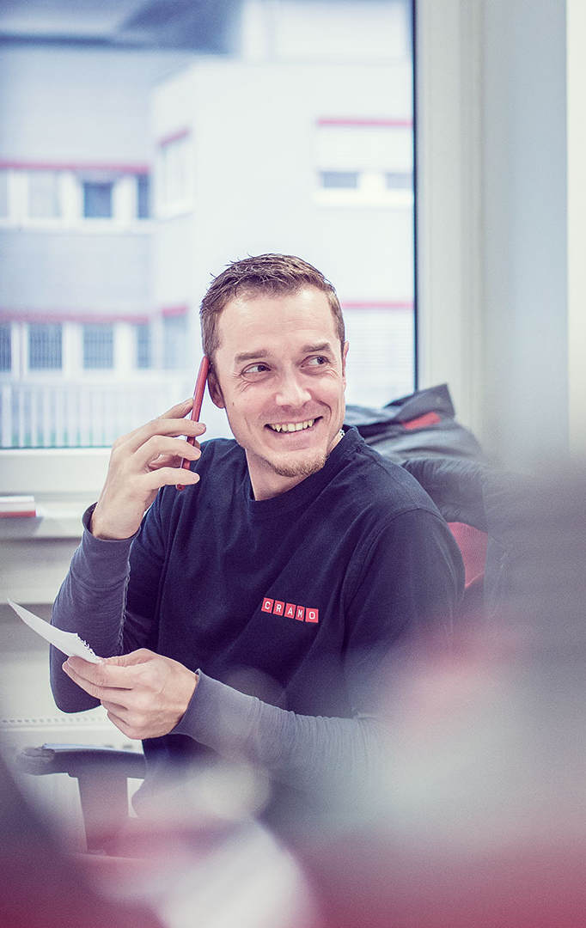
Employee Care
Our strategic target: Zero accidents
Cramo offers safe, stimulating workplaces for all our employees, where people of different ages and backgrounds have the same opportunities for development. We aspire to provide a stimulating environment for professional and personal development.
A systematic and preventative approach to safety should always be the highest priority.
Strategic target | Target | Outcome 2020 | Outcome 2019 | Status
Zero accidents | LTIR* 0 by 2023 | 8.2 | 7.8 | On-going – not on track
*Number of work-related accidents with at least one full day absence/million working hours.

Slide 39



We are Shapers
At Cramo, we focus on developing our employees, because we know that they are a key factor for us to be successful. We ensure that employees are high on the agenda and take responsibility for the development of our employees to go hand in hand with the company's overall strategy.
With our vision, goals and company DNA involve all our employees to jointly drive the company forward.
Attitude
Boels as One
Commitment
We are shaping our industry
We have the ambition to take our company and our industry to the next level. We find new ways to exceed our customers’ expectations.
Focus on people
We are on a journey of growth. We focus on developing our people to reach our full potential.
Passion for improvement
We have an open atmosphere.
Everyone can influence the future of Cramo and contribute with new ideas.
Shaping our industry, our business and our own future

Slide 40



Safety and Sustainability
Health and safety at customer sites and in our own work environment is our first priority and an integral part of our business. We provide a wide range of safety equipment as well as training and broader safety solutions. Our ambition is to make a strong contribution to zero accidents at customer jobsites.
Our sustainability strategy is aimed at strengthening our operations within the areas of Environmental, Social and Governance.
We have a long-term focus on sustainable use of our equipment, efficient transport and logistics and sustainable sourcing.
We put a strong focus on business ethics, occupational health and safety, reducing our environmental impact and taking an active part in the communities we operate in.
Sustainability is embedded in our strategy and way of working, our ambition is to contribute to advancing sustainability in the rental industry.

Slide 41
Cramo and the Sustainable Development Goals
Since 2009, Cramo has been a signatory to the UN Global Compact, supporting the ten principles with respect to human rights, labour, environment and anti-corruption.
Gender equality
A corporate culture based on diversity contributes to the positive future development of Cramo. Our target is to have 15% female employees within the operational organisation and 20% female man-agers by 2023
Decent work and economic growth.
Safety is our first priority and integral to our business. We have established solid processes and guidance to ensure the safe handling of our equipment.
We aim for zero accidents at job sites.
Responsible consumption and production.
Responsible sharing of resources is the core of our business with focus on sustainable customer use, transports and logistics and sustainable sourcing.
Notes:
The Sustainable Development Goals, established by the United Nations, address global challenges such as poverty, inequality, climate change, environmental degradation and peace and justice. The 17 goals are all interconnected, aiming at achieving a better and more sustainable future by 2030. They are relevant to each person, public and non-governmental organisation as well as to each company.
We have identified three goals where our actions have the highest impact. These, as well as all the other goals, are taken into consideration throughout our operations.
#5 Gender equality. A corporate culture based on diversity contributes to the positive future development of Cramo. Our target is to have 15% fe-male employees within the operational organisation and 20% female man-agers by 2023. We also want to develop alternative ways of meeting the de-mands from customers regarding diversity and gender equality. One such example is the projects we are running together with some of our major customers regarding gender equal site huts, i.e. site huts with solutions that enables for example separate changing facilities for men and women.
#8 Decent work and economic growth. Safety is our first priority and integral to our business. We have established solid processes and guidance to ensure the safe handling of our equipment. At all times and throughout the Cramo Group, priority is given to systematic and precautionary safety work, including risk assessment and identification of potential hazards. We aim for zero accidents at job sites.
#12 Responsible consumption and production. Responsible sharing of resources is the core of our business. Our ambition is to work together with our customers and other stakeholders to further decrease the environmental and social impact of rental equipment and to meet customer demands by focusing on sustainable customer use, transports and logistics and sustainable sourcing. One such example is Cramo Eco Choice, our programme to support our customers in replacing non-renewable fuels with renewable energy by promoting emission free and hybrid alternatives to diesel or petrol driven equipment.

Slide 42

ISO Certification in all markets
We aim to have the most satisfied customers in the industry and a leading market position in our chosen markets.
In 2017, we made the decision that all our markets should be certified according to ISO 9001, ISO 14001 and ISO 45001, or similar standards.
In 2020, we continued the work to establish and implement common Group policies, targets and processes with a focus on quality, environmental improvements, and health and safety.
Notes:
During 2020, Lithuania finalised its certification process for ISO 9001, ISO 14001 and ISO 45001.
ISO 9001 and ISO 14001 have now been implemented in all Cramo markets and ISO 45001 has been implemented in Sweden, Finland, Estonia, and Lithuania.
Norway is due to have the ISO 45001 certification or the like by the end of the current strategy period.

Slide 43
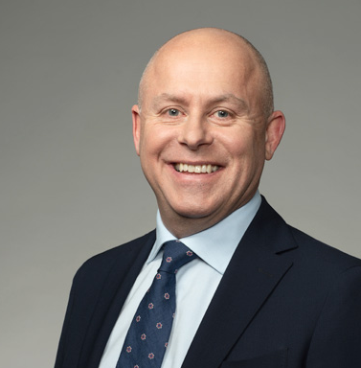
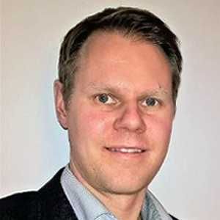


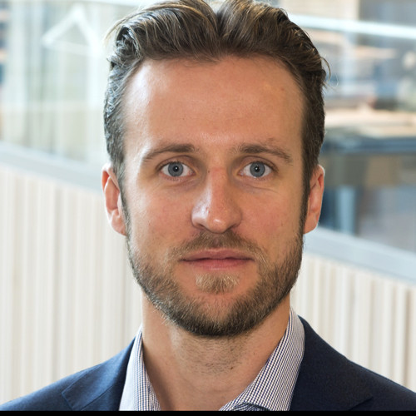
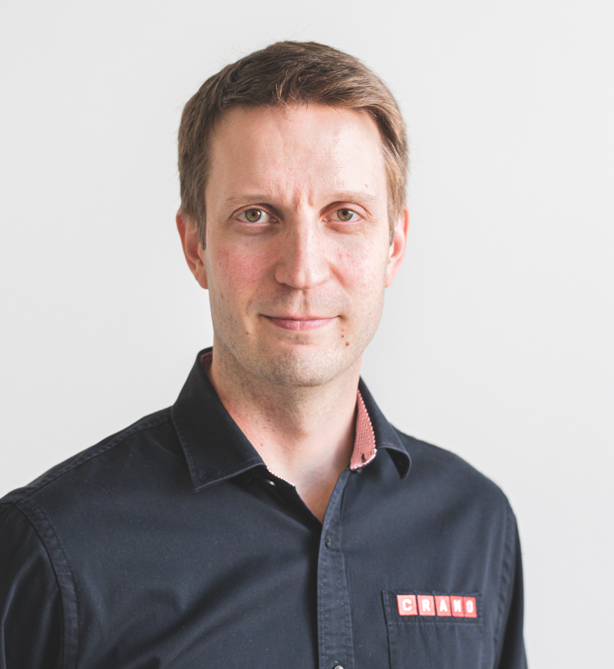
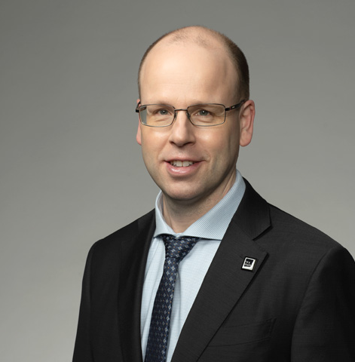
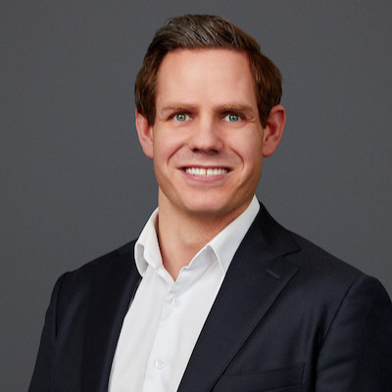
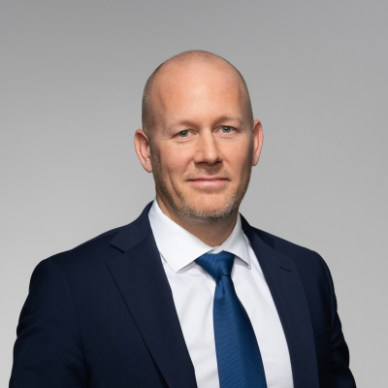
Cramo Group Management team
Martin Holmgren
President and CEO
Ville Halttunen, CFO
Sohana Josefsson, Group Staff Functions
Jonas Pärssinen, Strategy and Digital
Klāvs Otisons, Fleet Management and Baltics
Tatu Hauhio, Business and Operations development
Tuomas Myllynen, MD Finland
Thomas Astrup, MD Norway
Henrik Norrbom, MD Sweden

Slide 44


Slide 45

Cramo online
www.cramo.com
www.cramogroup.com
Cramo social media
www.linkedin.com/company/cramo-group
www.facebook.com/cramogroup
www.twitter.com/cramogroup
www.youtube.com/cramogroup

